Slide 1
HPC TNT - 2
Tips and tricks for Vectorization approaches to efficient code
HPC core facility CalcUA
Annie Cuyt ☐ Stefan Becuwe ☐ Franky Backeljauw ☐ [Engel]bert Tijskens

Slide 2
Overview
Introduction
What is vectorization
Why does it matter
When does it not matter
Different approaches
Case study – magnetization
Final remarks
Focus of this talk is on big picture and background not on the details

Slide 3
What is vectorization
do i=1,n
c(i) = a(i)+b(i)
end do
instr. | registers |  |  |  |  |  | main memory or cache
load a_{i} | a_{i} |  |  |  |  |  |  |  |  | b_{i}
 |  |  |  |  |  |  |  | a_{i}
load b_{i} | b_{i}
 |  |  |  |  |  |  |  |  |  |  | c_{i}
add
store c_{i} | c_{i}

Slide 4
What is vectorization
Vector width
do i=1,n,4
c(i:i+3) = a(i:i+3)+b(i:i+3)
end do
SIMD
Single Instruction
Multiple data
instr. | registers |  |  |  |  |  | main memory or cache
vload a_{i:i+3} | a_{i} | a_{i+1} | a_{i+2} | a_{i+3} |  |  |  |  |  | b_{i} | b_{i+1} | b_{i+2} | b_{i+3}
 |  |  |  |  |  |  |  | a_{i} | a_{i+1} | a_{i+2} | a_{i+3}
vload b_{i:i+3} | b_{i} | b_{i+1} | b_{i+2} | b_{i+3}
 |  |  |  |  |  |  |  |  |  |  | c_{i} | c_{i+1} | c_{i+2} | c_{i+3}
vadd
vstore c_{i:i+3} | c_{i} | c_{i+1} | c_{i+2} | c_{i+3}
Vector instructions

Slide 5
Vector width
Cpu | Instruction set | Vector width | Vector width SP | Vector width DP
Westmere | SSE4.2 | 128 bit | 4 | 2
Ivy bridge | AVX | 256 bit | 8 | 4 | Hopper
Haswell | AVX2 | 256 bit | 8 | 4
Xeon Phi | AVX-512 | 512 bit | 16 | 8
Failing to vectorize implies that your application runs at best at no more than 25% (12.5%) of peak performance for DP (SP)

Slide 6
when not to focus on vectorization (yet)
do i=1,n,4
c(i:i+3) = a(i:i+3)+b(i:i+3)
end do
instr. | registers |  |  |  |  |  | <- 250 cycles main memory <- 1cycle cache
vload a_{i:i+3} | a_{i} | a_{i+1} | a_{i+2} | a_{i+3} |  |  |  |  |  | b_{i} | b_{i+1} | b_{i+2} | b_{i+3}
 |  |  |  |  |  |  |  | a_{i} | a_{i+1} | a_{i+2} | a_{i+3}
vload b_{i:i+3} | b_{i} | b_{i+1} | b_{i+2} | b_{i+3}
 |  |  |  |  |  |  |  |  |  |  | c_{i} | c_{i+1} | c_{i+2} | c_{i+3}
vadd
vstore c_{i:i+3} | c_{i} | c_{i+1} | c_{i+2} | c_{i+3}

Slide 7
When not to focus on vectorization (yet)
Application with slow data traffic: every item needs to be fetched from main memory or from another node
Reorganize data layout
Sort data in the order the application needs them
use PerfExpert on Hopper to find out about data traffic problems

Slide 8
Organize data
State of all persons
List of ill people
List of healthy people
do i=1,n_ill:
do j=1,n_healthy
if contaminate(persons(ill(i)),persons(healthy(j)))
move_to_ill(healthy(j))
end do
end do
do i=1,n_ill:
do j=1,n_healthy
if contaminate(ill_persons(i),healthy_persons(j))
move_to_ill(healthy_persons(j))
end do
end do
State of ill people
State of healthy people

Slide 9
When not to focus on vectorization (yet)
Application saturates bandwidth
The bottleneck is not computation
Try to do all possible work on data when it is in cache (blocking/tiling)
If there is not much to compute vectorization will not help
use PerfExpert on Hopper to find out

Slide 10
Blocking/tiling
// inefficient
// except small problems
For all items
Do this
For all items
Do that
For all items
Do something else
// data transferred 3x
// efficient
// chunk = collection of items
// that fits in L1 cache
For all chunks
For all items in chunk
Do this
For all items in chunk
Do that
For all items in chunk
Do something else
// data transferred once

Slide 11
Approaches to vectorization
Assembly code
Intrinsics
Auto-vectorization by compiler
GCC
Intel compiler suite
low level library
boost.simd
Vc
Intel Cilk++
optimized high level library
Eigen
Intel MKL

Slide 12
Approaches to vectorization 1. Assembly
Write assembly code that use SIMD instructions (SSE, AVX, …)
for (int i = 0; i<N; ++i) C[i] = A[i] + B[i];
NEXT_ITERATION:
vmovups ymm1, ymmword ptr [edi+edx*4+8] ; copy 32 bytes from B to ymm1
vmovups ymm0, ymmword ptr [esi+edx*4+8] ; copy 32 bytes from B to ymm1
vaddps ymm1, ymm1, ymm0; add ymm0 to ymm1 and store the result in ymm1
vmovups ymmword ptr [ecx+edx*4+8], ymm1; copy 32 bytes from ymm1 to C
add edx, 8 ; increase loop index by 8
cmp edx, dword ptr [esi+4]
jg NEXT_ITERATION
V=AVX, mov=move, u=unaligned, p=packed, s=single precision

Slide 13
Approaches to vectorization 2. Intrinsics
Layer of data types and functions made available by compiler through include file (C/C++)
#include <immintrin.h>
...
__m256 ymm0, ymm1; //define the vector registers used
float a[8]={1,2,3,4,5,6,7,8};
float b[8]={2,3,4,5,6,7,8,9};
float c[8];
ymm0 = __builtin_ia32_loadups256(a); // ymm0 <= a
ymm1 = __builtin_ia32_loadups256(b); // ymm1 <= b
ymm0 = __builtin_ia32_mulps256(ymm0, ymm1); // ymm0 <= ymm0*ymm1
__builtin_ia32_storeups256(c, ymm0); // c <= ymm0
...

Slide 14
Approaches to vectorization assembly/intrinsics
Pro
Con
Can be very efficient
Hard, tedious, error-prone
Depend on hardware
Low level
assembly
Can be very efficient
Stay in the language
Only slightly less hard
Depend on hardware and on compiler
Only C/C++
intrinsics

Slide 15
Approaches to vectorization 3. Auto-vectorization
the compiler is your friend - let the compiler handle it
number of constraints
you can help the compiler
Compiler directives
Language extensions (restrict)
Pro
Con
usually efficient
relatively easy
depend (only) on compiler

Slide 16
Approaches to vectorization auto-vectorization
Constraints
inner loop only
loop count must be known in advance
single entry, single exit (no break)
no I/O
no branches (but you can use masks)
only intrinsic math functions and
C/C++ inlined functions, with no side effects
Fortran elemental functions
each iteration must be independent
a(i)=a(i-4)+b(i) is ok with vector length 2, not 4

Slide 17
Approaches to vectorization auto-vectorization
If the compiler cannot unambiguously decide that there is no dependency, the loop is not vectorized
Mind pointers in C/C++/Fortran!
double sum(double* a, double* b, double* c, int N) {
double ab=0;
for( int i=0; i<N; ++i ) c[i]=a[i]+b[i-2]
}
is not vectorized:
c may be an alias for b -> assumed dependency
double sum(double* restrict a, double* restrict b,
double* restrict c, int N) {
double ab=0;
for( int i=0; i<N; ++i ) c[i]=a[i]+b[i-2]
}
Fortran has arrays, C/C++ does not: double a[] is pointer too!

Slide 18
alignment issues - 1
array A, not aligned on 64 byte boundary
cache
vector registers
4 DP (256 bit)
cache line
0 bytes
64 bytes
128 bytes
192 bytes
array B, aligned on 64 byte boundary
alignment of arrays on 64 byte boundary can have important performance effect
increased pressure on prefetcher (every second vector comes from 2 cache lines

Slide 19
alignment of static arrays
linux C/C++
float A[1000] __attribute__((aligned(64)));
Fortran
real :: A(1000)
!dir$ attributes align: 64:: A

Slide 20
alignment of dynamic/allocatable arrays
linux C/C++ (unfortunately not very elegant)
operator new cannot handle alignment
replace malloc and free with _mm_malloc and _mm_free [intel compiler only]
Use of std::_aligned_malloc and placement new
http://cottonvibes.blogspot.be/2011/01/dynamically-allocate-aligned-memory.html
Intel TBB provides a portable cache_aligned_allocator
still must inform the compiler on alignment
void myfun( double *a, int n) {
__assume_aligned(a, 64);
for( int j=0; j<n; ++j )
++a[j];
}

Slide 21
alignment of dynamic/allocatable arrays
Fortran
real, allocatable :: a(:)
!dir$ attributes align:64 :: a
still must inform the compiler on alignment
!DIR$ ASSUME_ALIGNED A: 64
...
do i=1, N
A(I) = A(I) + 1
end do

Slide 22
alignment issues - 2
compute norm of vector : sqrt(x_{i}²+y_{i}²+z_{i}²)
AoS: a single array containing (x,y,z) triplets
SoA: separate array for x, y and z values
SoA: vector registers can be filled with contiguous memory = as efficient as it can get
AoS: vector registers must be filled by gathering noncontiguous elements
AoS
x0
y0
z0
x1
y1
z1
x2
y2
z2
…
x0
x1
x2
x3
…
xi
xi+1
xi+2
xi+3
y0
y1
y2
y3
…
vector registers
4 DP (256 bit)
yi
yi+1
yi+2
yi+3
SoA
z0
z1
z2
z3
…
zi
zi+1
zi+2
zi+3

Slide 23
Approaches to vectorization auto-vectorization
Compiler can provide vectorization report
Intel <15.0: -vec-report[=n]
n=0 no report
n=1 report vectorized loops
n=2 report vectorized and non-vectorized loops
n=3 2+report proven or assumed dependencies
n=4 report non-vectorized loops
n=5 4+reason why not
Intel >=15.0: -qopt-report[=n]
Generate optimisation report
n=0..5 increasing detail
Use report to understand and improve auto-vectorization

Slide 24
Approaches to vectorization auto-vectorization
Use compiler directives to help the compiler
Fortran !DEC$ directive
C/C++ #pragma directive
ivdep Instructs the compiler to ignore assumed vector dependencies (but not proven ones)
vector {aligned|unaligned|always|temporal|nontemporal}Specifies how to vectorize the loop and indicates that efficiency heuristics should be ignored. Using the assert keyword with the vector {always} pragma generates an error-level assertion message saying that the compiler efficiency heuristics indicate that the loop cannot be vectorized. Use #pragma ivdep! to ignore the assumed dependencies.
novector Specifies that the loop should never be vectorized.
simd Enforces vectorization of loops.

Slide 25
Approaches to vectorization auto-vectorization
Use compiler directives with care!
Assert that ignoring assumed dependencies are actually non happening
Compiler flags to force these directives application wide Use with even greater care!
GCC has auto-vectorization, but Intel compiler should be your first choice

Slide 26
Approaches to vectorization 4. Low level libraries
“architecture independent intrinsics”
The compiler translates the generic data types and operator/function calls into assembly instructions
uniform SIMD library interface
data types - functions
implementations for various hardware/instruction set combinations

Slide 27
Approaches to vectorization 4. Low level libraries
code can be compiled to
run even in the absence of SIMD hardware
select most efficient implementation available automatically at runtime!
handle alignment requirements
ideal for implementation of high level libraries
boost.simd is component of NT² Numerical Template Toolbox (not part of boost (yet?)):
github.com/MetaScale/nt2
Vc is found at gitorious.org/vc
Intel Cilk++

Slide 28
Approaches to vectorization low level libraries
Pro
Con
Efficient
Easy
Flexible
Depend on library (Boost.simd and Vc are interesting but small initiatives, support may stop at some point)
Only C/C++ (afaik)
Low level (but higher than intrinsics)

Slide 29
Approaches to vectorization 5. high level libraries
Formulate your problem in terms of library calls
Trust that library designers have done good job
E.g. Intel MKL, Eigen, ...
Pro
Con
Low development cost
Little coding/debugging/maintenance
Focus on problem
Depend on library
No competitive edge
Not so flexible

Slide 30
overview
preferred
choice
preferred
choice
if solving the problem is first concern
stay away
if portability is an issue
and software is first concern
 | assembly | intrinsics | auto-vect | low lvl lib | high lvl lib
efficiency | ++ | ++ | ++ | ++ | +
easy to use | -- | - | + | + | ++
flexibility | ++ | ++ | ++ | ++ | -
dependency | hardware | hardware Compiler | compiler | lib | lib
portability | - | - | + | ++ | ++
language | F90/C/C++ | C/C++ | F90/C/C++ | C/C++ | F90/C/C++

Slide 31
where to look for the details
https://software.intel.com/en-us/intel-software-technical-documentation
https://software.intel.com/sites/default/files/8c/a9/CompilerAutovectorizationGuide.pdf
https://software.intel.com/en-us/mkl_cookbook
https://software.intel.com/en-us/articles/vectorization-essential

Slide 32
case study
spin-waves-2.0
Prof Wim Magnus

Slide 33
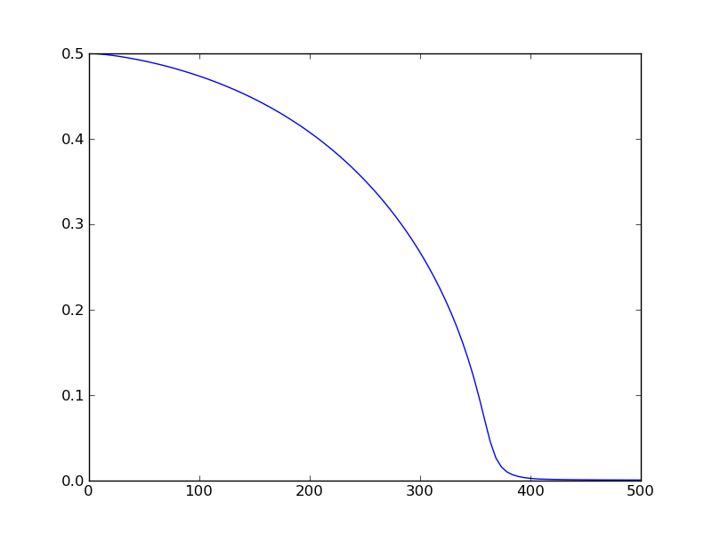


spin-waves-2.0
compute magnetization m(T) of bulk ferro-magnets
self consistent solution of

Slide 34

algorithm
loop over all T points (temperature)
initial guess m=0.5 (corresponding to Φ(m)=0)
update m = 1/(2+4*Φ(m)) until convergence
Φ(m) is computed as
Φ(m)=0
loop over n=1,∞
evaluate the integral using Gauss-Legendre-integratie on 64 points
term = (integral*α/π)³
if the term is too small break else Φ(m)+=term

Slide 35
algorithm
4 nested loops:
loop over T points
self-consistency iteration
loop over terms
loop over integration points
observation: runtime does not increase when auto-vectorization is disabled with compiler flag
-no-vec
auto-vectorization fails, but why?

Slide 36
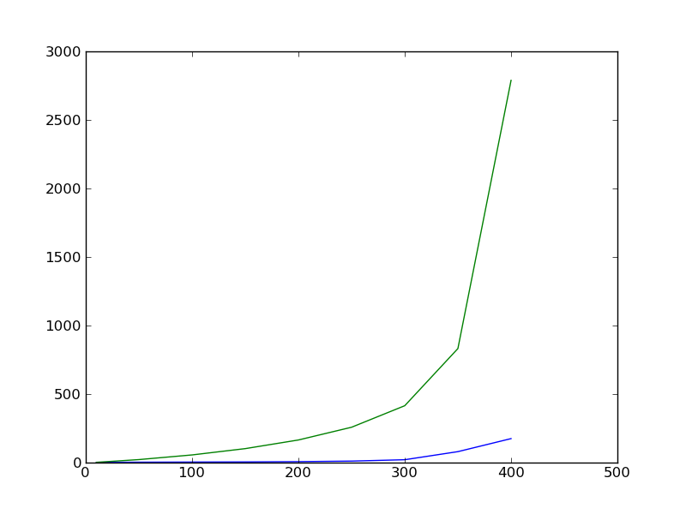
optimization 1
number of iterations in self-consistency loop vs T
initial guess
m(T) decreases monotonically
m(T_{i-1}) is a better initial guess than 0.5

Slide 37
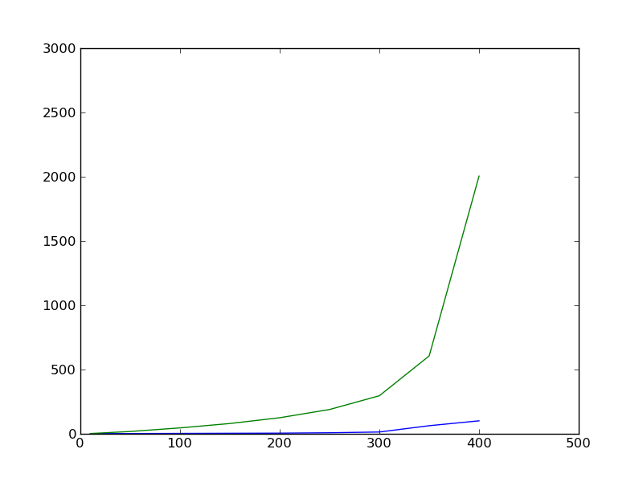
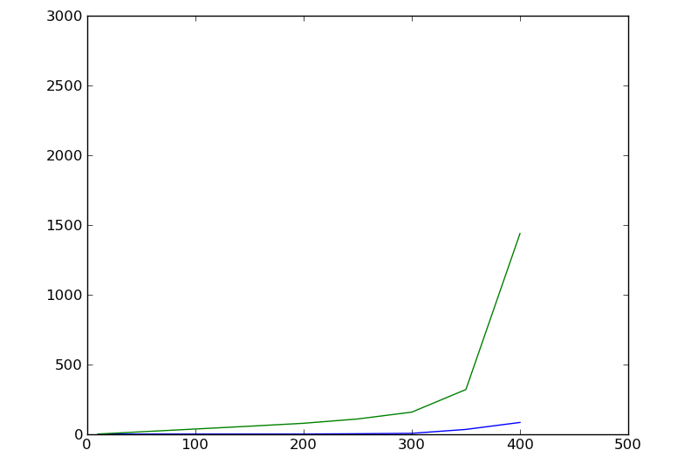
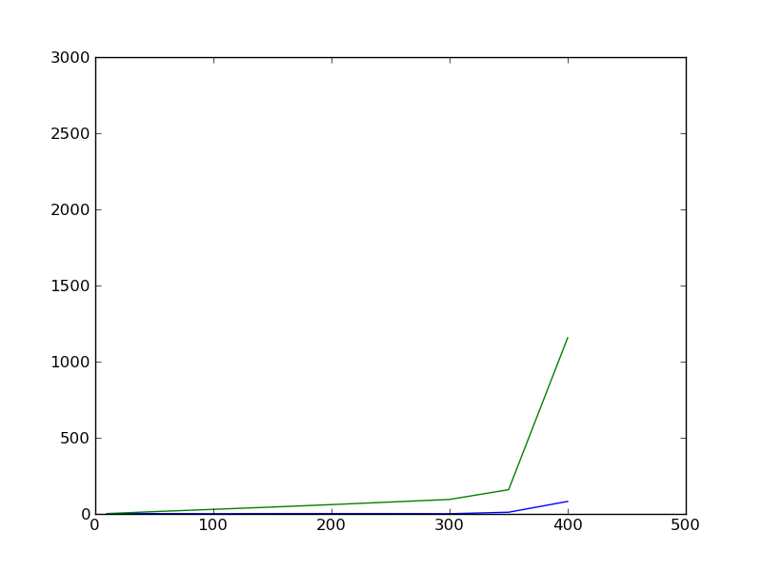
think about your problem when you code
m0(Ti) = 0.5
2789
m0(Ti) = m(Ti-1)
2789->2005
m0(Ti) = linear interpolation m(Ti-1), m(Ti-2)
2005->1439
m0(Ti) = quadratic interpolation m(Ti-1), m(Ti-2), m(Ti-3)
1439->1157
2789->1157 is roughly a speed up of 2.4

Slide 38
optimization 2
original code takes about 11 s to run
0.58 s is spent writing warnings to stdout
when m->0 there are problems with convergence of
the series
and the self-consistency loop
I/O is expensive – don’t write what you will never read
hundreds of times the same two warnings, better use a counter and report only once

Slide 39
vectorization
Gauss-Legendre integration implemented using allocatable array for integration points
the integrand is passed as function pointer
the integrand is implemented as an array valued function
takes an array of values : the integration points
returns an array of values : the function values at the integration points
array valued functions are a F90 feature.
The returned array is automatically allocated and deallocated
flexible and elegant but efficiency flaws:
lots of dynamical memory management
function pointer cannot be inlined => obstructs auto-vectorization

Slide 40
cure
hardcode Gauss-Legendre integration without function pointer (two lines of code)
elemental function allows a function that takes a scalar and returns a scalar to be applied to an array by embedding it into a vectorizable loop
FUNCTION Phi_integrand(ka)
REAL (SP), INTENT(IN) :: ka(:)
REAL (SP) :: Phi_integrand(SIZE(ka))
...
=>
ELEMENTAL FUNCTION Phi_integrand(ka)
REAL (SP), INTENT(IN) :: ka(:)
REAL (SP) :: Phi_integrand(SIZE(ka))
...

Slide 41
speedup
 | runtime [s] | speedup | total speedup
original code | 11.0
optimization 1 (m₀) | 4.51 | 2.43 | 2.43
optimization 2 (I/O) | 3.93 | 1.15 | 2.80
vectorization | 0.29 | 13.6 | 37.9
huh?
code uses single precision and AVX (256 bit)
vector width is 8 SP
expected speedup of 8x from vectorization
we gain an additional speedup of 1.7 due to removal of dynamic memory management that comes with the array valued function (integrand)
the 0.58 s spent in I/O (optimization 2) is significant in the final code : 0.29+0.58 is 3x slower

Slide 42
optimization 4
only 1 core used so far
parallellize over N cores
OpenMP
Intel TBB
…
only useful if the work load increases considerably
number of temperature points increases
single precision -> double precision (implies more iterations)
current setup overhead would probably be larger than speedup

Slide 43
Final remarks
think about the problem when you code
C++ can be as efficient as Fortran (Tips & Tricks 1)
Fortran also contains idioms that can kill performance (Fortran can be as inefficient as C++)
constructs that get in the way of vectorization are often inefficient by themselves
the speedup of vectorization can be larger than the vector width
it pays off to let me review your code
engelbert.tijskens@uantwerpen.be

